Slide 1
Faculty Development Program (FDP)

Slide 2
Program Overview
Introduction to Artificial Intelligence and its evolution
Types of AI (Narrow, General, Super AI)
Why AI matters in education today
Exploring the AI tool landscape (Content creation, Assessment, Research & Writing tools)
Understanding GPT technology and applications in teaching
Building and personalizing GPTs for academic use
Best practices for using AI responsibly in classrooms
Reflection & brainstorming on AI-driven teaching use-cases

Slide 3
Day 1-Introduction to AI & Exploring GPT Platforms

Slide 4
Session 1: Welcome & Icebreaker: Why AI in Education?

Slide 5
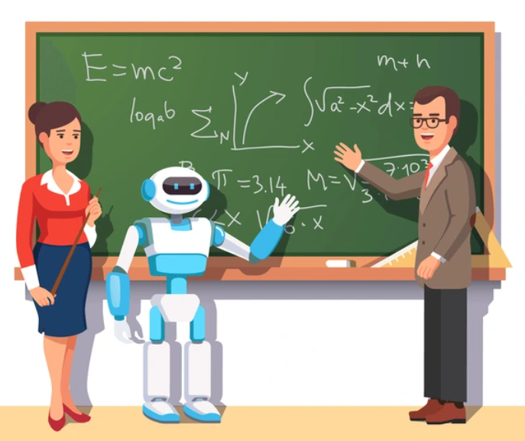
What is Artificial Intelligence?
Imagine you walk into class and say:
- Dear students, from today, I have a teaching assistant who never sleeps, never gets tired, and can answer your doubts instantly.
That assistant is Artificial Intelligence.
Formal definition: AI is when machines are built to think, learn and act like humans.
Simple example around us:
- Google maps predicting traffic
- Netflix recommending movies,
- Gmail finishing your sentences with smart replies
So AI is not future - it’s already in your pocket.

Slide 6
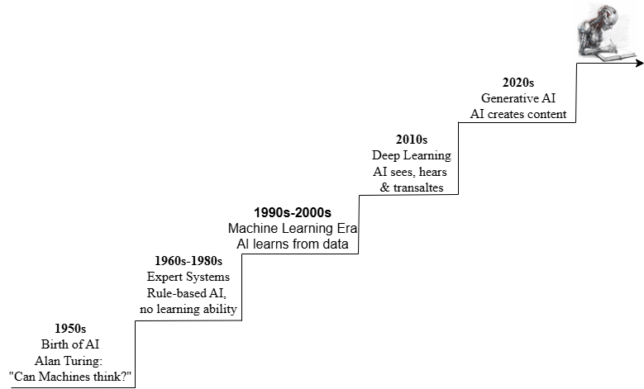
Evolution of AI

Slide 7
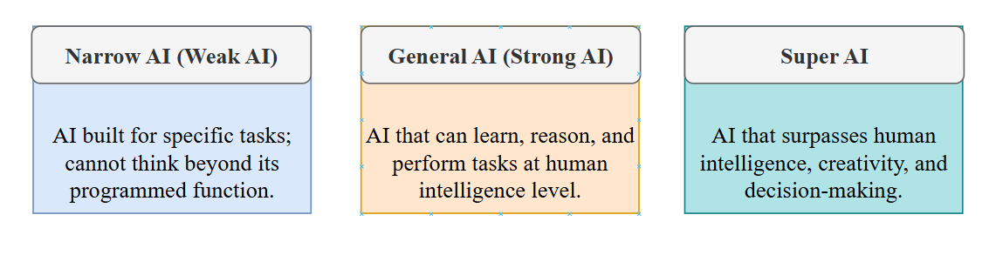
Types of AI
Artificial Intelligence is not just one thing it exists in different levels of capability, just like students in a classroom: some can do one subject really well, some can learn everything, and some might even surpass the teacher one day. Let’s break it down into three types:

Slide 8
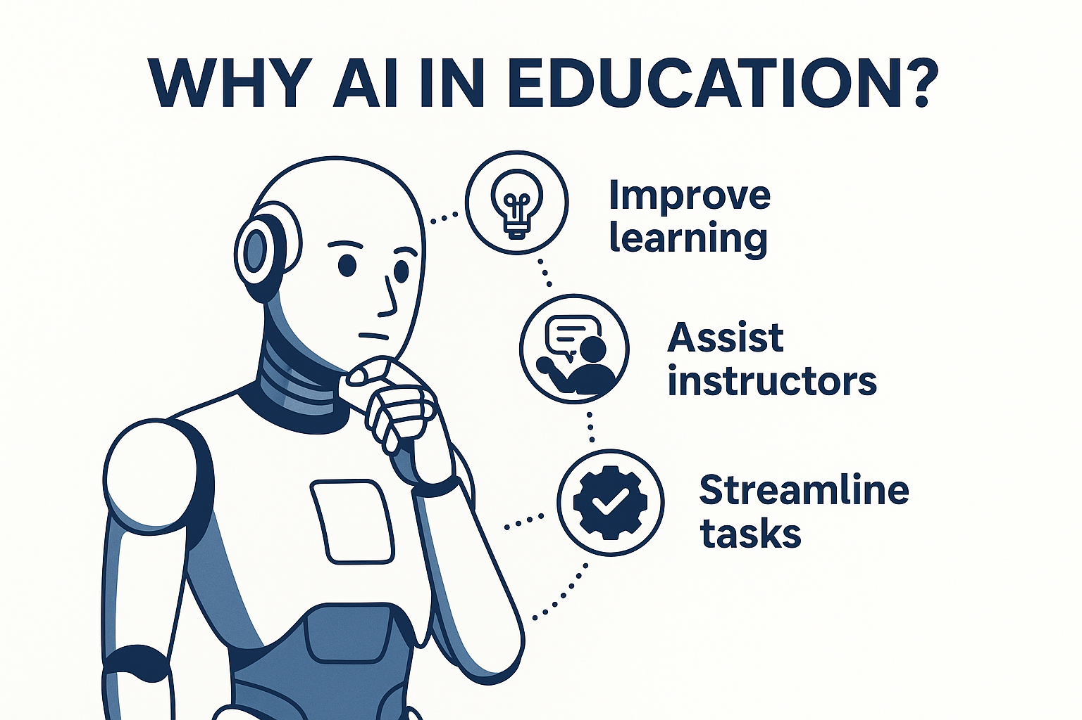
Why AI in Education?
Artificial Intelligence is not here to replace teachers, it is here to empower teachers. Imagine having an assistant who can handle repetitive work while you focus on inspiring and mentoring students. That is the real value of AI in education.

Slide 9


Slide 10



Slide 11
Session 1: Quiz
Q.1 Which of the following is an example of Narrow AI?
a) A self-learning robot that thinks like humans b) A chess-playing program like Deep Blue c) A future AI system smarter than humans d) None of the above
Answer: b)

Slide 12
Session 1: Quiz
Q.2 Alan Turing’s famous question “Can machines think?” laid the foundation of Artificial Intelligence. (True/False)
Answer: True

Slide 13
Session 1: Quiz
Q.3 Expert systems in the 1960s–1980s could learn from data. (True/False)
Answer: False

Slide 14
Session 1: Quiz
Q.4 Which type of AI is purely hypothetical and not yet achieved? a) Narrow AI b) General AI c) Super AI
Answer: c)

Slide 15
Session 1: Quiz
Q.5 Generative AI tools like ChatGPT and DALL·E belong to the current AI era (2020s). (True/False)
Answer: True

Slide 16
Session 2: Mapping the AI Tool Landscape

Slide 17
Introduction to the AI Tool Landscape
AI is like a digital toolbox for teachers each tool solves a different problem.
In this session, we focus on 3 free & practical categories of tools:
Content Creation: Notes, slides, images, videos
Assessment & Feedback: quizzes, polls, grading
Research & Writing: paraphrasing, summarizing, journal support
Goal: Know which tool to use, when to use it and how it can save time for professors.

Slide 18
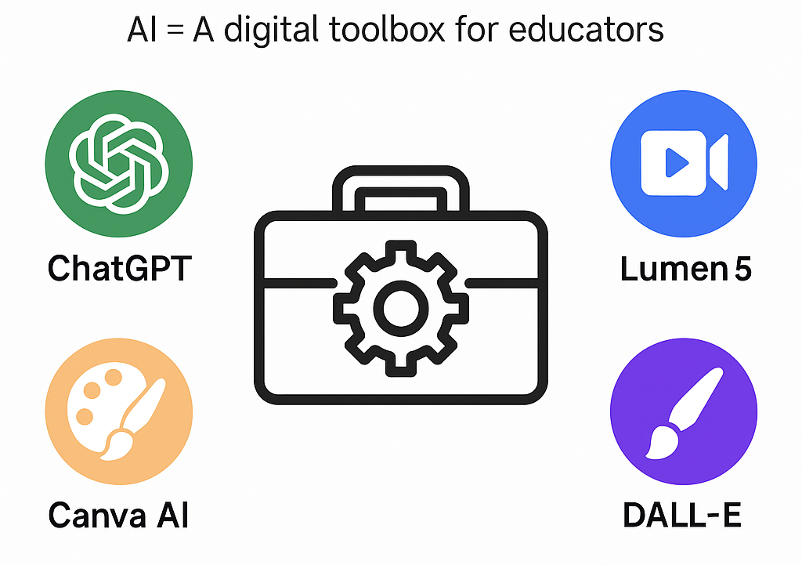
Category 1: Content Creation Tools
ChatGPT - Digital co-teacher for quick explanations, summaries, and quizzes.
Canva AI - Instantly design posters, slides, and diagrams for teaching.
DALL·E - Generate unique subject images (e.g., bridges, circuits) from text prompts.
Lumen5 - Turn text into short explainer videos for students’ self-paced learning.

Slide 19
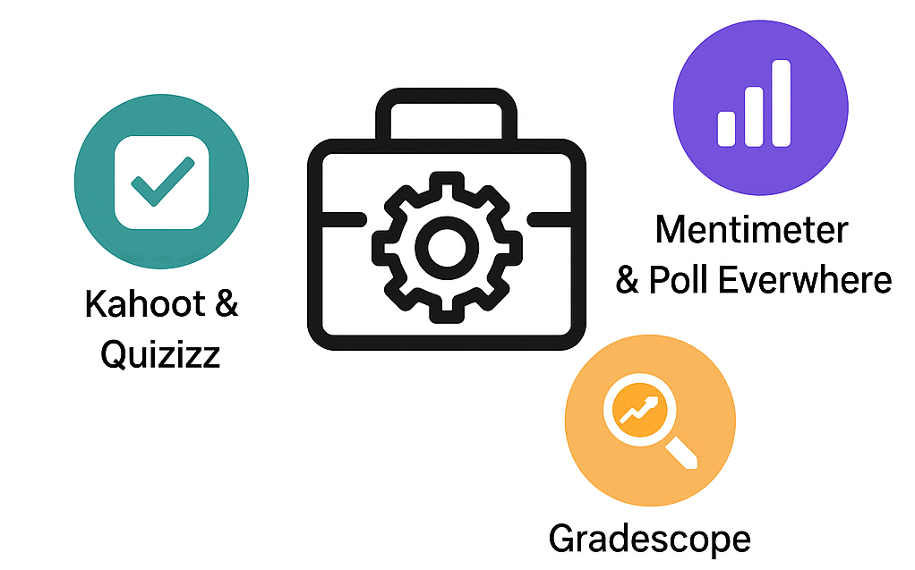
Category 2: Assessment & Feedback Tools
Kahoot & Quizizz: Game-based quiz platforms that make classes interactive. They allow teachers to run live quizzes and track student performance instantly.
Mentimeter & Poll Everywhere: Real-time polling tools for collecting student opinions. They create word clouds, quick surveys, and feedback during lectures.
Gradescope: AI-powered grading platform that checks assignments and exams. It saves time and provides fast, consistent feedback to students.

Slide 20
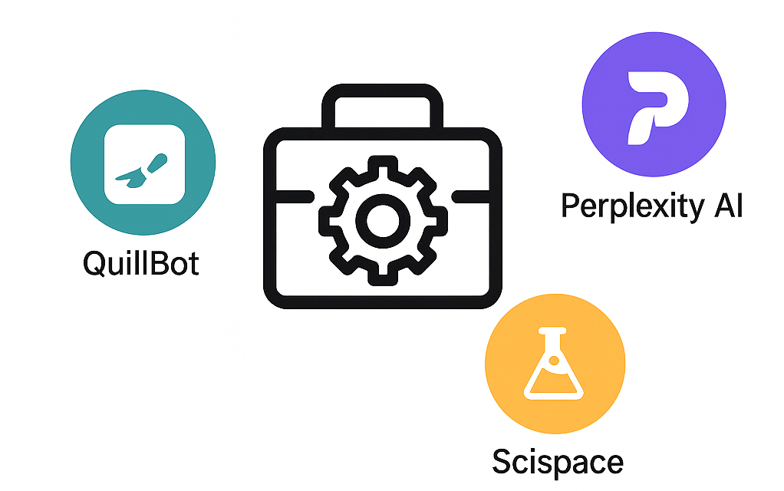
Category 3: Research & Writing Tools
QuillBot: Paraphrasing and grammar tool that refines writing for clarity and accuracy.
Perplexity AI: AI-powered search assistant that gives reliable, cited answers to research queries.
Scispace: Helps analyze, summarize, and explain research papers in simple terms.

Slide 21
Pros & Cons of AI Tools in Education
Pros | Cons
Saves time | Accuracy issues
Improves engagement | Over-dependence
Personalized support | Ethical concerns
Boosts research productivity | Limited free features
Free & accessible | Need digital skills

Slide 24
Session 2: Quiz
Q.1 Which of the following is an Assessment & Feedback tool? a) Canva AI b) Quizizz c) Lumen5 d) DALL·E
Answer: b)

Slide 25
Session 2: Quiz
Q.2 Match the following:
ChatGPT → Content creation
Gradescope → __________
QuillBot → __________
Answer: Gradescope → AI-powered grading; QuillBot → Paraphrasing and grammar

Slide 26
Session 2: Quiz
Q.3 Mentimeter can be used for creating live word clouds and real-time student polls. (True/False)
Answer: True

Slide 27
Session 2: Quiz
Q.4 Which of these tools is specifically designed to generate videos from text? a) Lumen5 b) QuillBot c) Canva AI d) Perplexity AI
Answer: a)

Slide 28
Session 2: Quiz
Q.5 The main goal of Session 2 (AI Tool Landscape) was: a) Learning coding for AI tool development b) Understanding which AI tool to use, when, and how it saves professors’ time c) Training GPT models from scratch d) Writing research papers with AI
Answer: b)

Slide 29
Session 3: GPTs 101 – Exploring ChatGPT & Custom GPTs

Slide 30
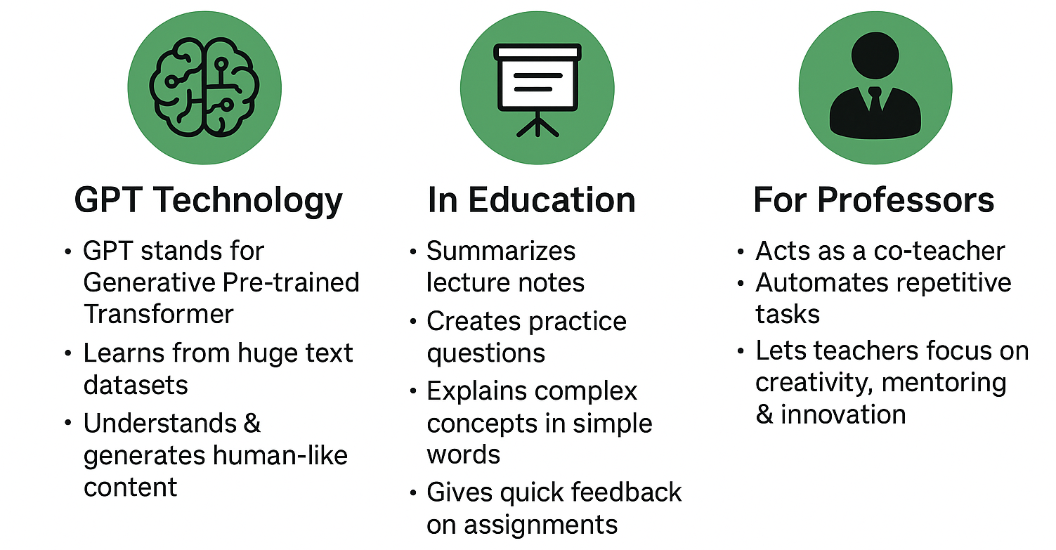
Introduction to GPT Technology

Slide 31
Getting Started: Account Creation
Using GPT tools is very simple and requires no coding skills. Faculty only need to create free accounts.
ChatGPT (OpenAI): Visit chat.openai.com → sign up with email or Google account → free plan gives access to GPT-3.5.
Poe.com (by Quora): Visit poe.com → one account gives you access to multiple AI models (GPT-3.5, Claude-Instant, etc.) for free.
Google Bard (now Gemini): Accessible through bard.google.com → free with a Google account.

Slide 32
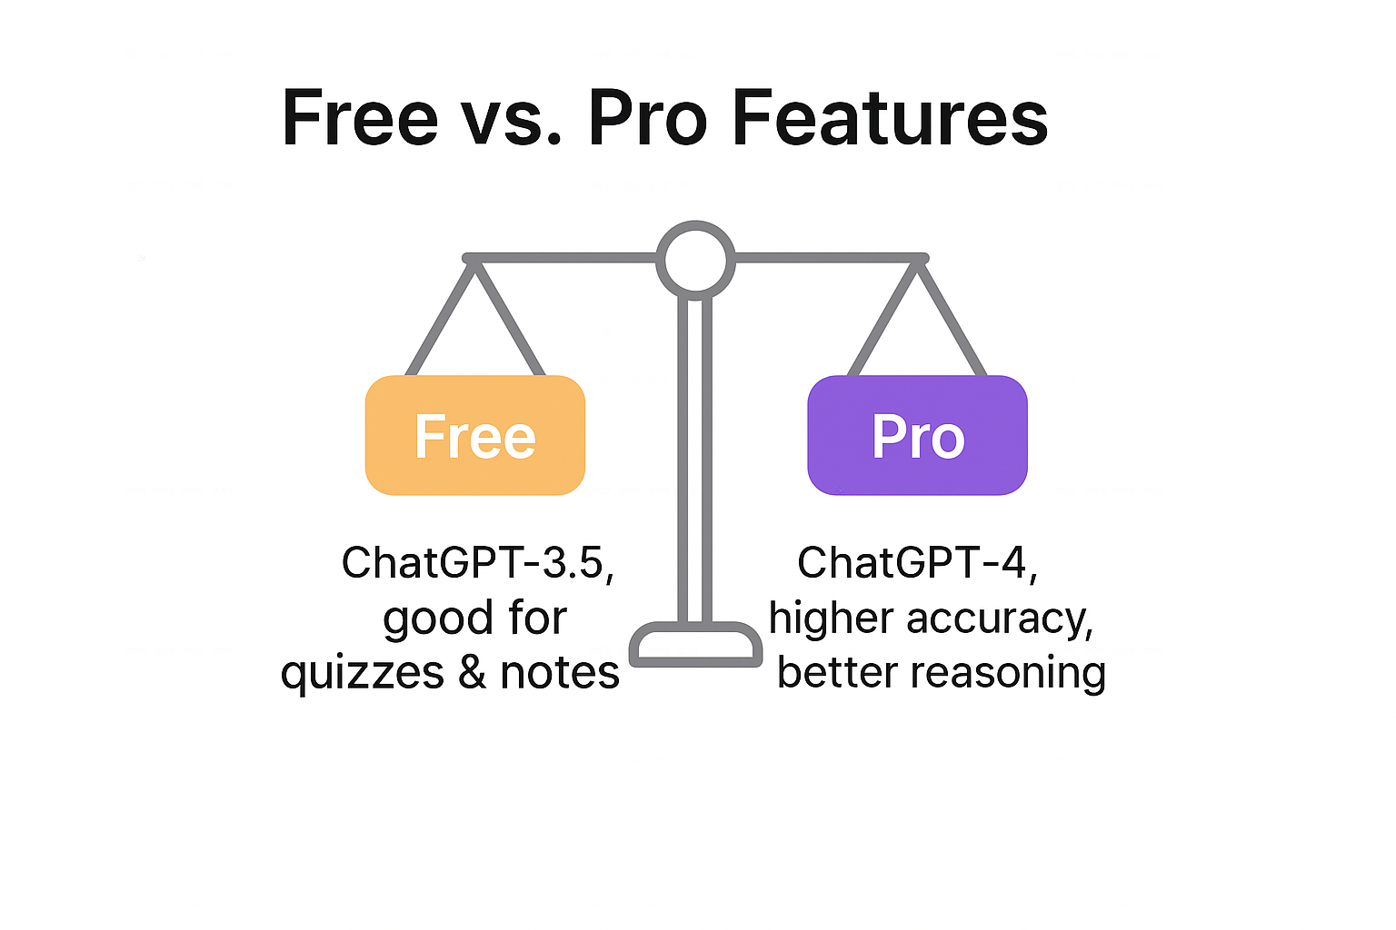
Free vs Pro Features
Free Plan: Good for lecture prep, quizzes, notes, and quick content creation. Best choice for classroom and FDP activities.
Pro Plan: Useful for research-heavy and advanced projects. Provides higher accuracy, deeper reasoning, and better handling of complex data.

Slide 33
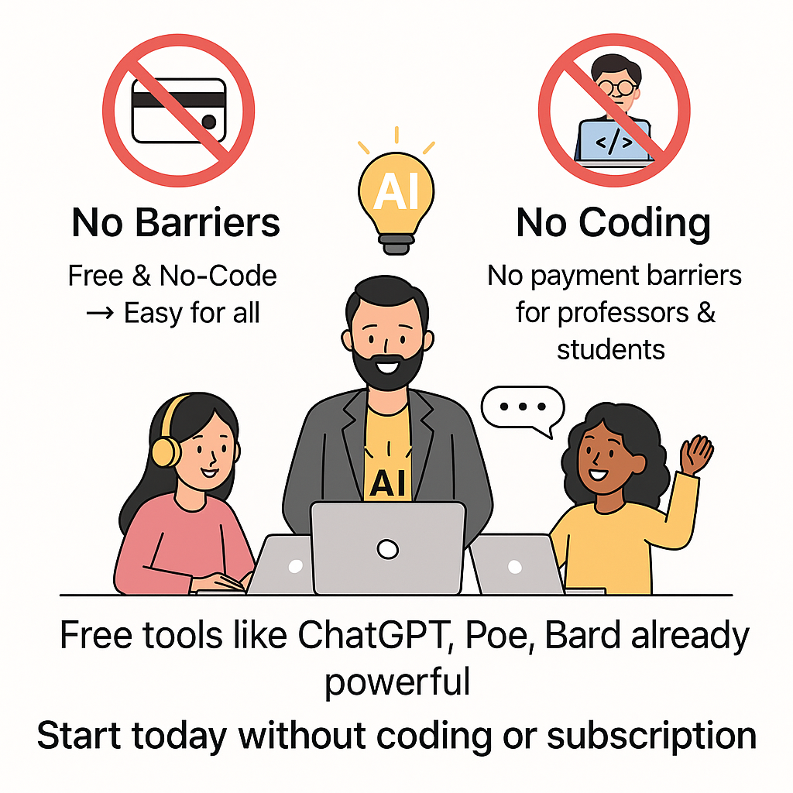
Why Only Free & No-Code Tools?

Slide 36
Session 3: Quiz
Q.1 GPT stands for __________. a) General Pre-trained Transformer b) Generative Pre-trained Transformer c) General Processing Transformer d) Generative Processing Tool
Answer: b)

Slide 37
Session 3: Quiz
Q.2 Which of the following is NOT a free, no-code GPT platform? a) ChatGPT (OpenAI) b) Poe.com c) Google Bard (Gemini) d) TensorFlow GPT Builder
Answer: d)

Slide 38
Session 3: Quiz
Q.3 Free GPT plans are best suited for: a) Running large-scale research simulations b) Preparing lectures, quizzes, and quick notes c) Handling complex datasets in finance d) Developing new programming languages
Answer: b)

Slide 39
Session 3: Quiz
Q.4 A Pro GPT plan provides better reasoning and deeper handling of complex data compared to free versions. (True/False)
Answer: True

Slide 40
Session 3: Quiz
Q.5 In the context of education, GPTs are best described as: a) Replacements for professors b) Co-teachers that assist with repetitive tasks c) Independent exam evaluators d) Entertainment bots
Answer: b)

Slide 43
Session 4: Building Your First Personalized GPT

Slide 44
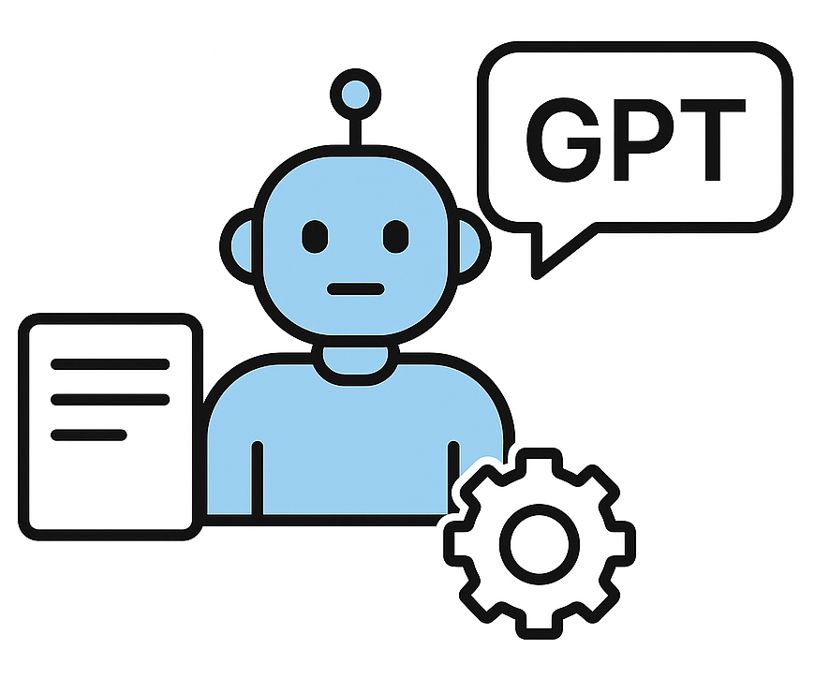
What is a Custom GPT?
A Custom GPT is like creating your own digital teaching assistant that follows your rules.
For example:
A Physics professor can build a GPT that always explains concepts with formulas + real-world applications.
A Computer Science professor can set it to act like a coding mentor, providing hints but not giving direct answers.

Slide 45
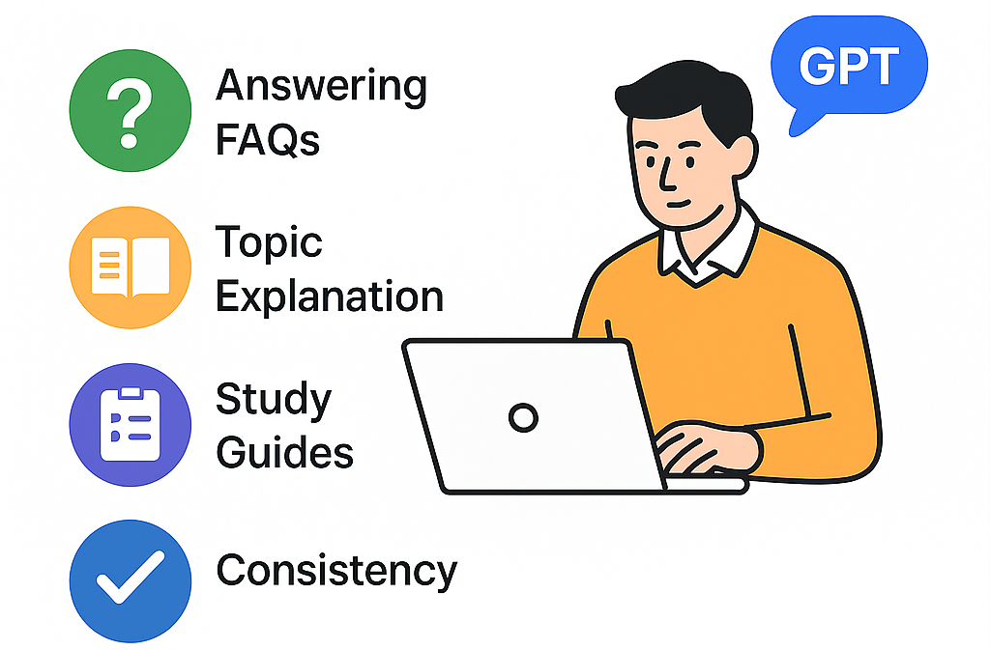
Benefits for Educators
A Custom GPT is not just a chatbot, it is a time-saving partner for professors.

Slide 46
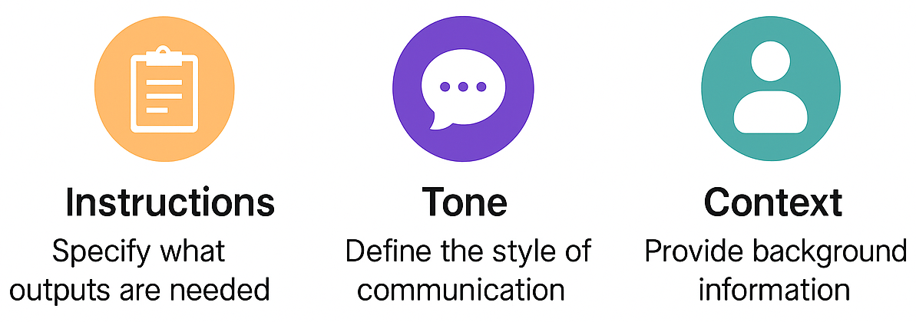
Setting up Instructions, Tone & Context
A Custom GPT works best when the instructions are crystal clear.
Think of it like teaching a new assistant, the more specific you are, the better it performs.

Slide 47
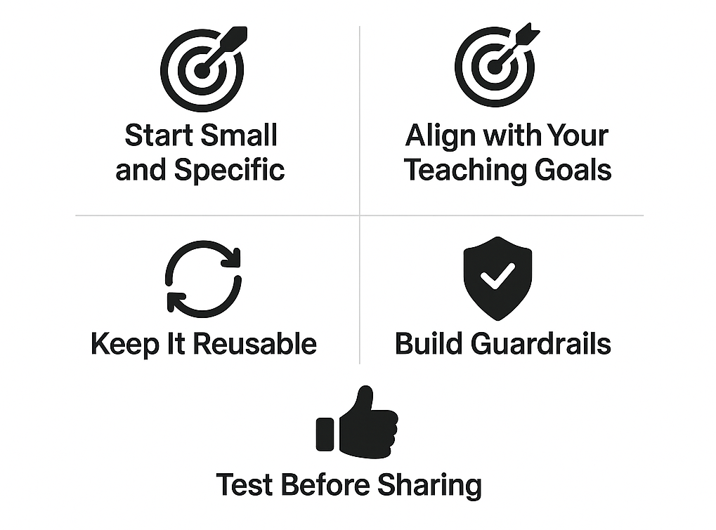
Best Practices for Defining Use-Cases
A Custom GPT becomes powerful only when the use-case is well defined. Random instructions lead to random results.

Slide 50
Session 4: Quiz
Q.1 What is a Custom GPT in the context of education? a) A general chatbot available to everyone b) A digital assistant tailored with specific rules and tone for your subject c) A paid-only AI service with coding requirements d) A search engine for academic papers
Answer: b

Slide 51
Session 4: Quiz
Q.2 Which of the following is a key benefit of Custom GPTs for educators? a) Replaces professors completely b) Handles repetitive FAQs and provides consistent explanations c) Generates fake citations automatically d) Removes the need for teaching altogether
Answer: b

Slide 52
Session 4: Quiz
Q.3 In setting up a Custom GPT, which element defines how the GPT should respond (formal, friendly, student-friendly)? a) Instructions b) Tone c) Context d) Persona Card
Answer: b

Slide 53
Session 4: Quiz
Q.4 What is an example of aligning Custom GPT use-cases with teaching goals? a) Asking GPT to generate memes for fun b) Generating 5 Bloom Level 3 questions for Unit-2 c) Making GPT write assignments for students d) Using GPT only for email replies
Answer: b

Slide 54
Session 4: Quiz
Q.5 Which best practice ensures Custom GPTs are safe and reliable for classroom use? a) Skipping trial runs to save time b) Allowing GPT to create any content without restrictions c) Building guardrails and testing prompts before sharing with students d) Giving GPT no clear instructions
Answer: c

Slide 55
Session 5: Daily Challenge & Reflection

Slide 56
Recap of Key Learnings
Today we explored how AI can empower educators rather than replace them.
Learned about:
Basics of AI, its evolution & types,
AI tools for content, assessment, and research,
GPTs and how to personalize them for teaching
Key message: AI saves time on routine tasks → professors can focus on mentorship & innovation.

Slide 57
Identifying Classroom Problems
Every professor faces repetitive challenges in teaching.
Example challenges:
Preparing question banks every semester
Giving quick feedback on assignments
Keeping students actively engaged during lectures
Task: Identify 1-2 classroom problems that AI could help solve.
Remember: The more specific the problem, the easier it is to design an AI solution.

Slide 58
Peer Discussion & Feedback
Faculty share their AI use-case ideas in small groups.
Peer feedback helps refine:
Is the problem clearly defined?
Is the AI tool chosen appropriate?
Are learning outcomes aligned?
Outcome: Stronger, realistic classroom use-cases shaped by collective input.

Slide 59
Closing Reflection
AI is not about knowing every tool, it’s about solving real classroom problems.
Faculty walk away today with:
A clearer understanding of AI in education
A draft use-case plan for their own subject
Confidence to start experimenting tomorrow
Quote to end the day:
“ Innovation in education starts when teachers reimagine their own classrooms.”

